Slide 1
Bringing Home the Banking
Grade 12+

Slide 2

A Special Note for Teachers

Slide 3
Students will…
Learn about how banks make money
Learn about concepts such as fractional reserve banking
Discuss consumer protection services such as CIDC insurance
Explore banks, near banks, and payday loan companies

Slide 4
Academic Language
CIDC insurance
Fractional reserve banking
Mortgage
Investments
Payday loans
Near bank

Slide 5

What is a Bank?
Watch this video to learn about the banking system: https://www.youtube.com/watch?v=fTTGALaRZoc&t=1s

Slide 6
What is a Bank?
Banks take customer deposits and lend the money out to other individuals and businesses.
In return, banks pay interest to their customers.
Canadian banks have CIDC Insurance on customer accounts.
Banks also provide services such as investing and advising customers.

Slide 7
Chartered Bank
Before 1867, banks in Canada were chartered (regulated) by royal assent (permission).
In 1980, the federal government allowed banks to be created by letter patents issued by the Ministry of Finance.
They are subject to the Bank Act which defines what banking is, what is required to start a bank, what businesses a bank can be involved in, and more.
Canada has five banks known as the Big 5: Royal Bank, CIBC, Bank of Nova Scotia, Bank of Montreal, and TD Bank, although there are other, smaller chartered banks.

Slide 8
Benefits of CIDC insurance
Gives depositors peace of mind that their money is insured and “safe”
Allows banks to carry very little reserves (actual money on hand)
Covers up to $100,000 per bank account
Amount above $100,000 is not covered

Slide 9
Drawbacks of CIDC insurance
Banks must pay an insurance premium each year to qualify for CIDC insurance
Can lead to excessive risk-taking and “moral hazard”
Banks are not nervous about losses, since the taxpayers will bail out the banks if they go bust
Allows banks to take huge lending risks, since the taxpayers back their risk-taking

Slide 10

Banks
Have CIDC insurance
Receive and hold deposits.
Holds some money in the form of reserves.
Banks charge more for the loan than they pay out in interest.
Makes loans to people.

Slide 11
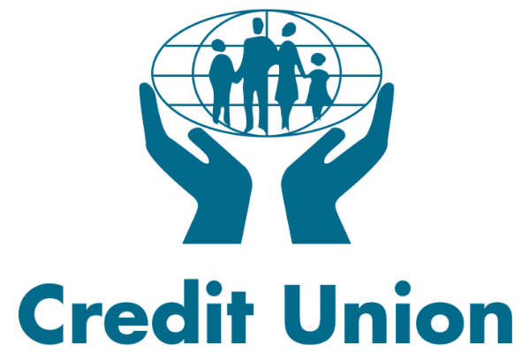
Credit Unions
Similar to banks but differ in important ways
Are financial cooperatives that are owned by their members
Not-for-profit! Whereas banks are profit-driven organizations
Generally, they offer slightly higher interest rates on savings
Does not have CIDC insurance but is often guaranteed. In some cases, deposits are backed 100%. The amount of backing depends on the province.

Slide 12

Credit
Unions
Insured up to 100% of deposits (Not CIDC)
Receives and hold deposits.
Charge interest on loans and pay dividends and interest to shareholders.
Credit unions are full reserve.
Credit unions lend money.

Slide 13
Near banks: Banking Alternatives
Companies that serve as banking proxies
These companies will often cash cheques, make loans, or extend credit to under-served populations.
These bank-like companies serve populations who do not have easy access to banks due to socio-economic, geographical or other reasons.
Some examples are payday loan companies, various grocery stores with cheque-cashing services, and the post office.

Slide 14




Payday Loans
Not a bank at all
You can take out money instantly at very high interest rates
These companies are marketed as if they were doing you a favour, but they are actually charging you very high fees. (See a visual on slide 16)
Often offered to the most vulnerable populations

Slide 15
Payday Loans
How payday loan companies justify for charging high interest rates:
Customers are “high risk” of default, so they need high rates to make up for lost revenue from delinquent loans.
It’s a short-term loan.
They provide an instant loan service with no credit check.
Customers are not forced to borrow from them.
Loans become delinquent when the borrower does not make a payment by the due date.

Slide 16
Payday Loans
Why we need to be aware of the high interest rates:
Payday are often offered to vulnerable populations who may already be struggling financially.
The rates are extremely high, sometimes as high as 300-500% when calculated on an Annual Percentage Rate basis (APR).
Compare this with credit cards, which charge 15-30% APR.
It is easy to get caught in a debt spiral and not be able to get out.
For a visual of how high these interest rates are, click here.

Slide 17
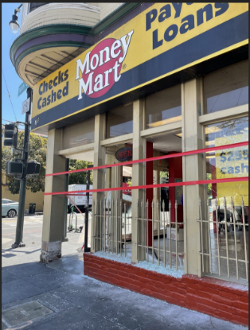

Payday Loans
Payday loans often get a bad reputation because of the high interest rates.
But are they truly bad?
Do they take advantage of people’s financial situation, or do they offer a lifeline with a high cost?
Do the high interest rates truly reflection the risks associated with the borrowers and their ability to pay?
Watch the following three videos in order to form your own opinion on the subject.

Slide 18
Payday Loans
Watch the following videos and complete the worksheet activity.
The pros and cons of payday loans: Should You Get a Payday Loan? (Pros and Cons) - YouTube
The case for payday loans: The Benefits of Payday Loans | Do You Agree? - YouTube
The case against payday loans: The 'overwhelming burden' of the payday loan cycle – YouTube
For news articles and reports on payday loans, see slide 28.

Slide 19

Payday
Loans
Loans are often short-term in nature.
Easy to get caught in a debt spiral.
The interest rates on these loans are very high.
Loans require little to no credit check, so any one can borrow.
Offered to individuals who cannot access bank loans.

Slide 20
Other banking proxies: Grocery Stores
In remote communities, grocery store chains often act as a bank-like entity for individuals.
They offer services such as cashing cheques and extending credit for purchases.
Competition is low in small, remote communities, so these companies often charge higher fees for cashing cheques than a bank.
Stores also may require in-store purchases before cashing cheques.

Slide 21
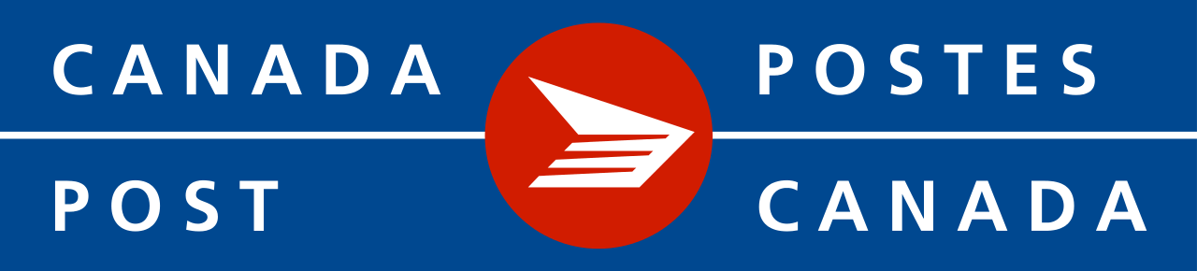
Other banking proxies: Post Office
Able to cash cheques
Readily available in most communities
Fees are generally lower than payday or grocery stores
Can be a much longer wait to cash cheques at busy times

Slide 22

Debt Spiral
High rates of interest charged by near banks can lead to huge problems, including the debt spiral.
A debt spiral happens when payments become bigger than people can afford.
Often, getting caught in a debt spiral can lead to bankruptcy.
For more info: Debt Spiral Explained - Economics Help

Slide 23

Near Banks: Food for Thought
On the positive side…
They tend to service under-served communities
There is little to no credit check required to use them
Service is often instant, or very close to instant
Nevertheless…
Interest rates are markedly higher than is available at a bank or credit union
Very real possibility of entering a debt spiral
If you pay these high fees, it will impact future savings and spending goals

Slide 24
Loan Application Scavenger Hunt
Banks, credit unions and payday loan companies make their money from loans.
In order to make money, they need to be sure that their borrowers can pay back the money that is loaned to them.
Therefore, there are certain criteria they ask before giving out a loan.
Question: What do you think some of those criteria are?

Slide 25
Loan Application Scavenger Hunt
Take a look at the loan application web sites on slide 27. Feel free to search for another loan application on your own.
What are some common questions that appear on the loan applications?
What information do the companies ask for on the loan?
Why do you think they ask for these particular pieces of information?

Slide 26
Role Play! Activity
Find a partner or small group.
One of you will be the banker (or near-banker). The other will be the loan applicant.
You will discuss a couple of options:
  Is the applicant able to get a loan at your institution? Why or why not?
  Would the applicant choose to get a loan at your institution? Why or why not?
  What might be an alternative institution they may get a loan at?
  What sorts of rates might the applicant be eligible for, and why might they get that rate?

Slide 27
Role Play! Resources
Bank loan applications:
Welcome - RBC True House Affordability Mortgage Prequalification (royalbank.com)
TD Mortgage Affordability Calculator | TD Canada Trust
Credit union loan applications:
Home Equity Loans | Alpine Credits Ltd.
Loan Application | (unitedcreditunion.com)
Payday loan applications:
Payday Loan Calculator (omnicalculator.com)
PrestoBroker (prestocash.app)

Slide 28
Resources and References
News reports on payday loans:
Global News takes a look at Easy Financial
CBC’s hidden camera investigation of Canada’s payday loans
References:
Payday Loans: Disadvantages & Alternatives (debt.org)
Chartered Banks in Canada | The Canadian Encyclopedia
Credit Unions in Canada 2023: The Complete Guide (savvynewcanadians.com)

