Slide 1
Macroeconomics:
Consumer Price Index (CPI)
Grade 12+

Slide 2

A Special Note for Teachers

Slide 3
Macroeconomics
“Macroeconomics is a branch of economics that studies how an overall economy – the markets, businesses, consumers, and governments – behave.”
Source: Investopedia
Macroeconomics include:
Inflation
Price levels
National income
Gross Domestic Product (GDP)
Unemployment rate
…and more

Slide 4
Students will…
Learn about the purpose and components of indices, with a focus on the Consumer Price Index (CPI)
Understand how the CPI measures inflation
Calculate rates of inflation
See how larger institutions use the CPI to make policy decisions
Important note: Macroeconomics is a complex branch of study. Many factors play a role. This lesson shows only a few aspects of macroeconomics related to price levels.

Slide 5
Academic Language
Consumer Price Index (CPI)
Index (Plural: Indices or Indexes)
Inflation
Deflation
Components
Representative products
Selection bias
Spending power

Slide 6
What is an index?
Indices are created to measure financial or economic data such as interest rates, inflation, stock market performance, and more.
In the case of financial markets, stock and bond market indices consist of a “basket” of securities to replicate a certain area of the market.
Indices can be used as benchmarks, or a standard, to measure other things.
Note: The plural terms “indices” and “indexes” are often used interchangeably. In this lesson, we will use “indices”.
Source: Investopedia

Slide 7

Examples of indexes
Standard & Poor’s 500 Stock Market Index (S&P 500)
Toronto Stock Market Index (TSX 60)
Producer Price Index (PPI)
Canada New Housing Price Index
Consumer Price Index (CPI)
Feel free to explore these indexes to learn about what they measure.

Slide 8
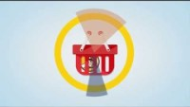
Consumer Price Index (CPI)
An index that affect our day-to-day life is the Consumer Price Index. It measures price changes in the goods and services we buy as consumers.
Watch an introductory video: https://www.youtube.com/watch?v=qfKmJe3CK6E

Slide 9
Consumer Price Index (CPI)
The CPI is a basket of goods and services that Canadian households purchase regularly.
Every month, the CPI adds up the costs and tracks the month-over-month change in prices.
The main purpose of the CPI is to measure inflation (prices going up) or deflation (prices going down).
What items are included in the CPI? Take a quick glance: Representative Products of the CPI

Slide 10

CPI and Inflation
Explore: Find out the cost of a basket of goods many years ago compared with the same basket today: https://www.bankofcanada.ca/rates/related/inflation-calculator/
(The instructions are on the link.)
Are a basket of goods and services a lot more expensive today?
The difference in the price level is inflation.
Let’s dig deeper to see what goods and services are in the CPI basket.

Slide 11
Components of the CPI
The CPI includes 8 major components:
Food
Shelter
Household operations, furnishings and equipment
Clothing and footwear
Transportation
Health and personal care
Recreation, education and reading
Alcoholic beverages, tobacco products and recreational cannabis
Source: Consumer price index portal (statcan.gc.ca)
Discuss: Out of these 8 components, what do you spend the most money on?

Slide 12
Components of the CPI: Weightings
In the video we watched, the government finds that an average Canadian spends more money on gas and milk. So, the CPI assigns heavier weights to those items.
Components that make up a larger portion of a typical person's spending have a heavier weight. It takes up a larger part of the CPI.
Components that make up a smaller portion of a typical person’s spending have a lighter weight. It takes up a smaller part of the CPI.
Go to this link and see the basket weights: Official Consumer Price Index (CPI) basket weights and monthly adjusted consumer expenditure basket weights (statcan.gc.ca)

Slide 13
Pause and Discuss
What is the weight for shelter (housing) in the CPI?
What about transportation?
What about food?
What is the component with the lightest weight in the CPI?
In your opinion, does the weighting represent how you spend money? Why or why not?
In your opinion, which component(s) should have a heavier weight in the CPI?
Which component(s) should have a lighter weight?

Slide 14

Regional CPI
This video explains how people experience inflation differently: https://www.statcan.gc.ca/en/sc/video/cpi2

Slide 15
Representative Products of the CPI
Each component is made up of many representative products used by people across Canada.
For example:
Food
  Butter
  Strawberry jam
  Sugar
Look at the representative products included in the CPI: Representative Products of the CPI
Then, answer the discussion questions on the next slide.
Component
Representative Products

Slide 16
Pause and Discuss
What are the goods and services included in the current CPI? Write down some of the representative products that you and your household purchase regularly.
How often does the CPI change the basket? Do you know which products they changed?
What are some of the products that you do not buy regularly? Write these down.
Do you feel the CPI is a good representation of your own shopping habits? Why or why not?
Do you think the CPI is a good representation of all Canadian’s purchasing habits? Why or why not?

Slide 17
Regional CPI
Of course, Canadians living in different regions shop differently.
Statistics Canada creates regional CPIs to better match people’s spending habits across the country.
Regional CPIs measure inflation across various Canadian regions and cities.
Explore: Research “regional CPI Canada” online for the most recent data. Or click on this link: Consumer Price Index by geography

Slide 18

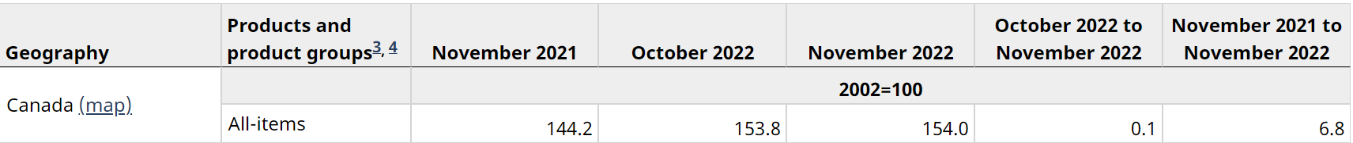

Understanding the CPI
After clicking the link, you may see something like this:
Comparing the same month year-to-year
Consumer Price Index number
Rates of inflation

Slide 19
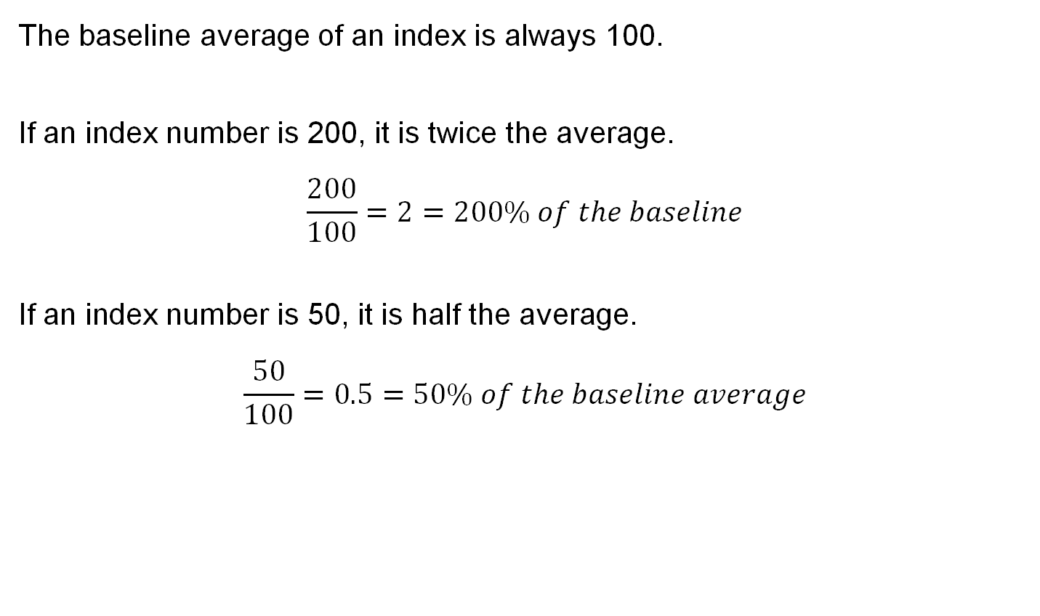
Understanding the CPI
The baseline average of an index is always 100.
If an index number is 200, it is twice the average.
$$\frac{200}{100}=2=200\% of the baseline$$
If an index number is 50, it is half the average.
$$\frac{50}{100}=0.5=50\% of the baseline average$$
Notice the index number and the corresponding percentage are the same. This is the reason that an index is based on 100, so no calculations need to be done!

Slide 20



Understanding the CPI
The year 2002 is the baseline for this CPI.
144.2% of year 2002
154% of year 2002
Consumer prices went up 144% in 2021 compared with 2002!
Consumer prices went up 154% in 2022 compared with 2002!!

Slide 21


Pause and Discuss
If an apple costed $1.50 in 2002, how much did an apple cost in 2022 according to the CPI?
If your favorite sweater costed $28 in 2002, how much would it be to replace your favorite sweater in 2022?
This is inflation, and it affects us all.
Let’s see how to calculate the inflation rate, so we can be more informed as consumers.
$$154\%×\$1.50=\$2.31$$
$$154\%×\$28=\$43.12$$

Slide 22
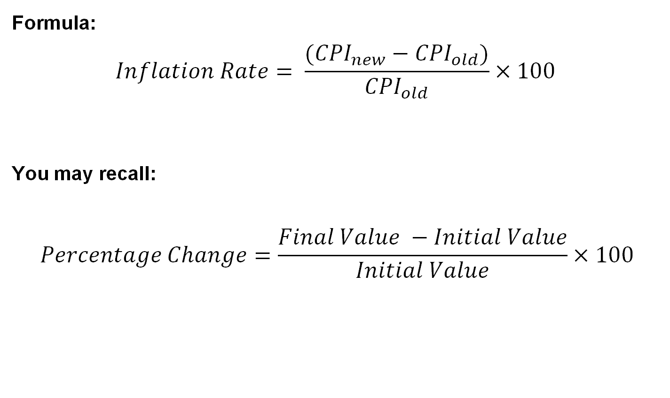
How is inflation rate calculated?
Formula:
$$Inflation Rate= \frac{({CPI}_{new}−{CPI}_{old})}{{CPI}_{old}}×100$$
You may recall:
$$Percentage Change=\frac{Final Value −Initial Value}{Initial Value}×100$$

Slide 23

Understanding the CPI
Comparing the same month year-to-year
Rate of inflation from Nov 2021 to Nov 2022
$$Inflation Rate=\frac{(154−144.2)}{144.2}×100=6.8\%$$

Slide 24
Understanding the CPI
Go back: Research “regional CPI Canada” online for the most recent data. Or click on this link: Consumer Price Index by geography
Choose 2 or more regions in Canada.
Look at the latest CPI numbers. How do they compare to the baseline average?
Calculate the rates of inflation. Do your calculations match what is presented on the CPI?

Slide 25
Discussion Questions
Explain the rates of inflation to a partner. What do the rates of inflation tell you about consumer prices?
How do the inflation rates in the different Canadian regions compare with each other?
Currently, which Canadian region faces the highest inflation? What might be some reasons for this?
Those who earn a salary would like to see a pay raise equal to the inflation rate. Does it happen often in real-life? If not, how does this affect the people and their spending power?
Optional: Research current news reports on inflation and consumer spending power. What are the current topics?

Slide 26
CPI and Central Banks
CPI informs institutions that make decisions for the overall economy, including the Bank of Canada – the Canadian central bank.
To learn more about the Bank of Canada, how they affect the economy, and how this impacts us, see the lesson: “Macroeconomics: Central Banks”.
The Bank of Canada aims to keep inflation rate at 2% from year-to-year.

Slide 27
Bias
CPI collects pricing data from across Canada. Any kind of data collection and interpretation can include bias.
In the case of the CPI, there is a potential for selection bias. After all, the CPI is made up of a selection of items, and those items are chosen by someone.
Look into it: Who chooses the basket of goods and services for the CPI? Who decides on the weights of the components?
Institutions like the Bank of Canada uses the CPI to make policy decisions that affect all of us.
The Government of Canada

Slide 28

Bias
Do you think there is a potential for moral hazard? Would the government want to manipulate the CPI to their advantage?
Yes. The government is incentivized to adjust the CPI in a way that paints a better picture of the economy.
Understanding how the Bank of Canada operates, the government can adjust the CPI to influence the central bank’s decisions indirectly.
Final thought: This does not mean that we should
overlook the CPI. However, we must see it with a
critical eye and realize that it can give a sunnier view
than reality. We also want to know who creates the
CPI, what their motivations are, and who makes
important decisions that affect us all.

Slide 29

Exit Slip
What are three things you learned about the CPI and inflation?
In your opinion, why is it important to understand the CPI and inflation?
What caution should we take when looking at the CPI?

Slide 30
Additional Resources
Personal Inflation Calculator from Statistics Canada: Allows you to estimate your personal inflation rate based on your household expenses.
Consumer Price Index Data Visualization Tool from Statistics Canada: Interactive tools that allow you to customize CPI data by basket components, geography, and time periods back to the year 1914.
Consumer Price Index: Frequently Asked Questions from Statistics Canada

